Slide 1
Diabetic Prediction
By
AYUSH KESARWANI
PRIYANSHU GANGWAR
SHIVANSH PRATAP SINGH
B.TECH(3RD YEAR) - VISION
LLOYD INSTITUTE OF ENGINEERING

Slide 2
Abstract
Diabetes is considered as one of the deadliest and chronic diseases which causes an increase in blood sugar. Many complications occur if diabetes remains untreated and unidentified.
The tedious identifying process results in visiting a patient to a diagnostic center and consulting doctor. But the rise in machine learning approaches solves this critical problem.
The motive of this study is to design a model which can prognosticate the likelihood of diabetes in patients with maximum accuracy.

Slide 3
Table of Content
Introduction
Existing Method
Proposed method with Architecture
Methodology
Implementation
Conclusion

Slide 4
Introduction
Diabetes is an illness which affects the ability of the body in producing the hormone insulin, which in turn makes the metabolism of carbohydrates abnormal and raises the levels of glucose in the blood.
Many researchers are conducting experiments for diagnosing the diseases using various algorithms of machine learning approaches like Logistic regression, SVM, KNN , Decision Tree, Random Forest etc. as researches have proved that machine-learning algorithms work better in diagnosing different diseases.
This study focuses on pregnant women suffering from diabetes. In this work, Logistic Regression, SVM, KNN, Random Forest and Decision Tree machine learning algorithms are used and evaluated on the PIDD dataset to find the prediction of diabetes in a patient. Experimental performance of all the five algorithms are compared on various measures and achieved good accuracy .

Slide 5
Existing Method
Algorithms Used :
Support Vector Machine (SVM)
Logistic Regression
Decision Tree Classifier
KNN
Random Forest

Slide 6
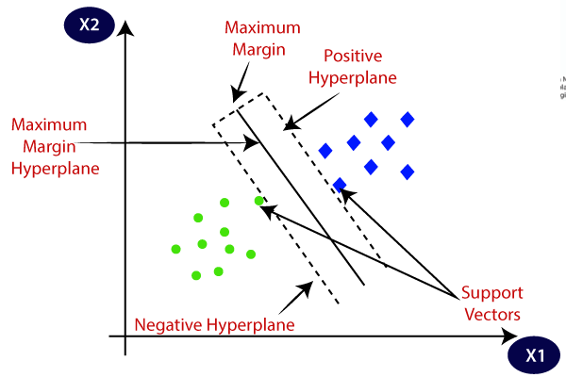
Support Vector Machine
SVM is one of the standard sets of supervised machine learning models employed in classification. Given a two-class training sample the aim of a support vector machine is to find the best highest-margin separating hyper planes between the two classes. For better generalization hyper planes should not lie closer to the data points belonging to the other class. Hyper planes should be selected which is far from the data points from each category. The points that lie nearest to the margin of the classifier are the support vectors .

Slide 7
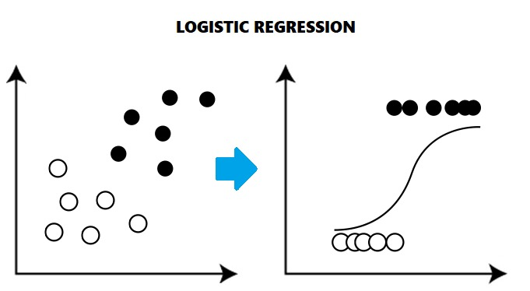
Logistic Regression
Logistic regression models the probability of the default class (e.g. the first class).
For example, if we are modeling people’s sex as male or female from their height, then the first class could be male and the logistic regression model could be written as the probability of male given a person’s height, or more formally:
P(sex = male | height)

Slide 8
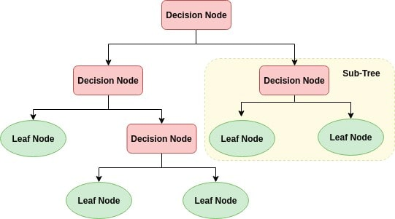
Decision Tree Classifier
Decision Tree is a supervised machine learning algorithm used to solve classification problems.
The main objective of using Decision Tree in this research work is the prediction of the target class using decision rules taken from prior data. It uses nodes and internodes for the prediction and classification.
Root nodes classify the instances with different features. Root nodes can have two or more branches while the leaf nodes represent classification.
In every stage, the Decision tree chooses each node by evaluating the highest information gain among all the attributes .

Slide 9
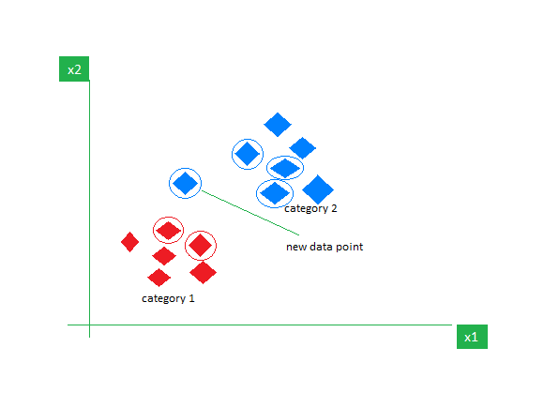
KNN
The K-Nearest Neighbors (KNN) algorithm is a supervised machine learning method employed to tackle classification and regression problems. Evelyn Fix and Joseph Hodges developed this algorithm in 1951, which was subsequently expanded by Thomas Cover. The article explores the fundamentals, workings, and implementation of the KNN algorithm.
What is the K-Nearest Neighbors Algorithm?
KNN is one of the most basic yet essential classification algorithms in machine learning. It belongs to the supervised learning domain and finds intense application in pattern recognition, data mining, and intrusion detection.
It is widely disposable in real-life scenarios since it is non-parametric, meaning it does not make any underlying assumptions about the distribution of data (as opposed to other algorithms such as GMM, which assume a Gaussian distribution of the given data). We are given some prior data (also called training data), which classifies coordinates into groups identified by an attribute.

Slide 10
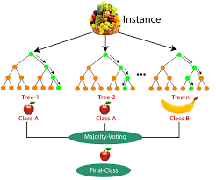
Random Forest
Random Forest algorithm is a powerful tree learning technique in Machine Learning. It works by creating a number of Decision Trees during the training phase. Each tree is constructed using a random subset of the data set to measure a random subset of features in each partition. This randomness introduces variability among individual trees, reducing the risk of overfitting and improving overall prediction performance.
In prediction, the algorithm aggregates the results of all trees, either by voting (for classification tasks) or by averaging (for regression tasks) This collaborative decision-making process, supported by multiple trees with their insights, provides an example stable and precise results. Random forests are widely used for classification and regression functions, which are known for their ability to handle complex data, reduce overfitting, and provide reliable forecasts in different environments.

Slide 11
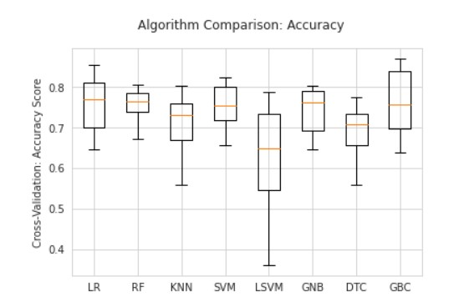
Accuracy Score
Logistic regression (LR) outperforms in the accuracy score when compared to other algorithms like decision tree (DTC) and support vector machine (SVM) as we take it into consideration for this study.
The accuracy score of the logistic regression algorithm is 82.46 %.
The accuracy score of the Random Forest algorithm is 77.48 %.
The accuracy score of the support vector machine is 77.27 %.
The accuracy score of the Decision Tree is 70.99 %.
The accuracy score of the KNN is 73.05 %.

Slide 12
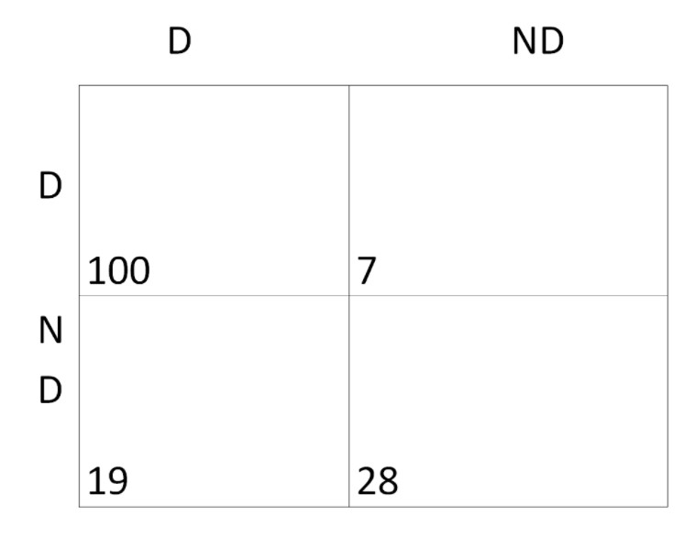
Confusion Matrix (LR)
The model correctly predicted those who have diabetes with a precision of 100 / 154.
It also accurately predicted those who do not have diabetes with a precision of 28 / 154.
The model wrongly interpreted the diabetic patients as non diabetic with a precision of 7 / 154 and also the non diabetic ones as diabetic patients with a precision of 19 / 154.

Slide 13
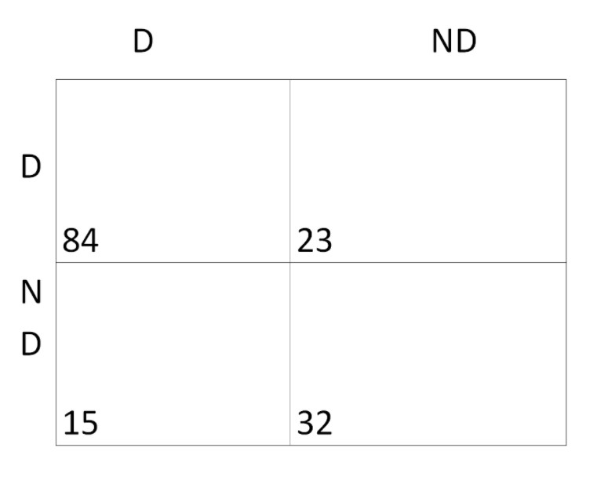
Confusion Matrix (DTC)
The model correctly predicted those who have diabetes with a precision of 84 / 154.
It also accurately predicted those who do not have diabetes with a precision of 32 / 154.
The model wrongly interpreted the diabetic patients as non diabetic with a precision of 23 / 154 and also the non diabetic ones as diabetic patients with a precision of 15 / 154.

Slide 14
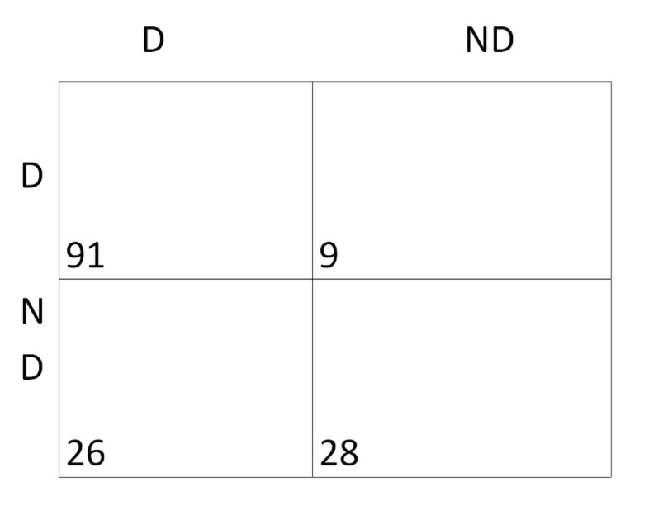
Confusion Matrix (SVM)
The model correctly predicted those who have diabetes with a precision of 91 / 154.
It also accurately predicted those who do not have diabetes with a precision of 28 / 154.
The model wrongly interpreted the diabetic patients as non diabetic with a precision of 9 / 154 and also the non diabetic ones as diabetic patients with a precision of 26 / 154.

Slide 15
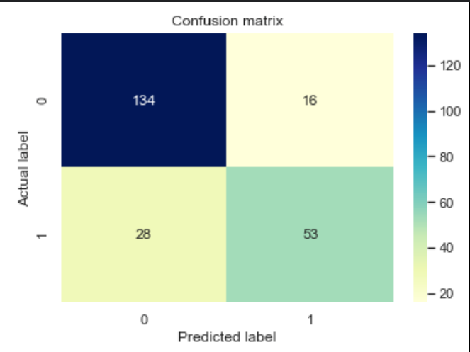
Confusion Matrix (KNN)
The model correctly predicted those who have diabetes with a precision of 134 / 154.
It also accurately predicted those who do not have diabetes with a precision of 16 / 154.
The model wrongly interpreted the diabetic patients as non diabetic with a precision of 28 / 154 and also the non diabetic ones as diabetic patients with a precision of 53 / 154.

Slide 16
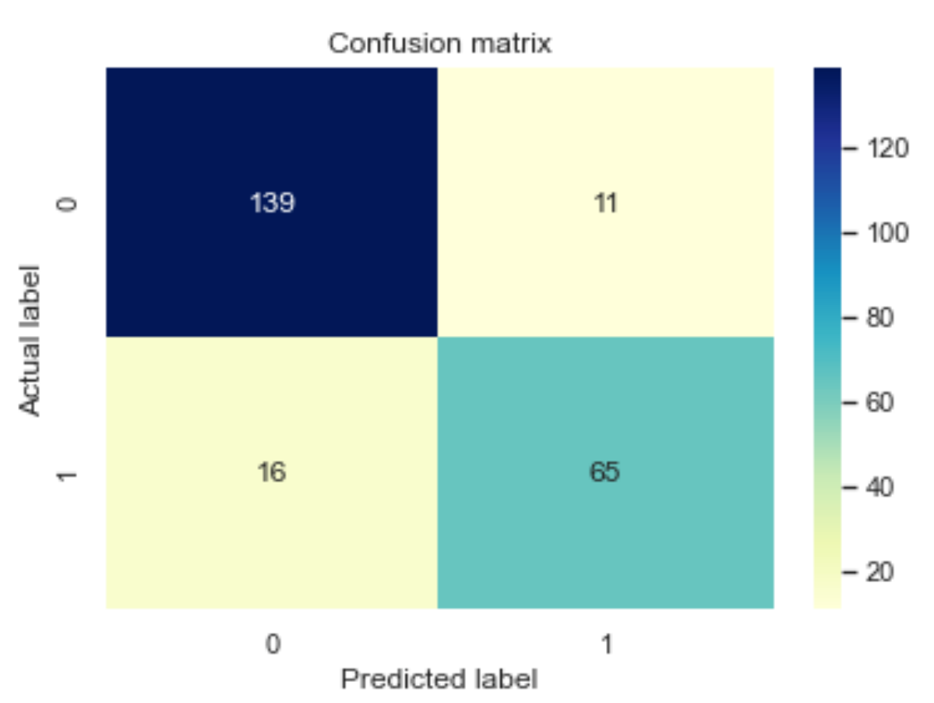
Confusion Matrix (Random Forest)
The model correctly predicted those who have diabetes with a precision of 139 / 154.
It also accurately predicted those who do not have diabetes with a precision of 11 / 154.
The model wrongly interpreted the diabetic patients as non diabetic with a precision of 16 / 154 and also the non diabetic ones as diabetic patients with a precision of 65 / 154.

Slide 17
Dataset Used
PIDD - Pima Indians Diabetes Dataset
The proposed methodology is evaluated on the Diabetes Dataset (PIDD) , which is taken from UCI Repository. This dataset comprises medical details of 768 instances which are female patients. The dataset also comprises numeric-valued 8 attributes where value of one class ’0’ is treated as tested negative for diabetes and value of another class ’1’ is treated as tested positive for diabetes.

Slide 18
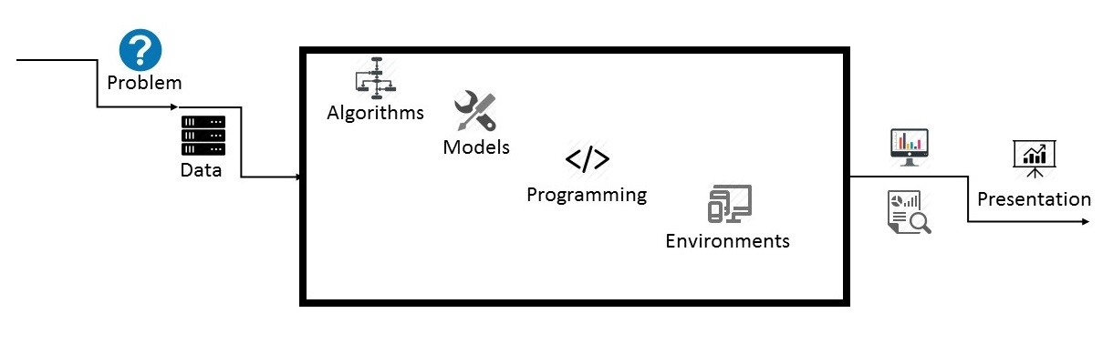
Proposed Method with Architecture
Problem
Data
Working model
Presentation

Slide 19
Problem
Problem statement can be anything from building a prediction models, building a market segmentation, building a recommendation engine, association rule discovery for fraud detection, minimizing production costs, minimizing advertisement costs, maximizing ROI, right rewards to right users, right offers from offline to online to right users, best deals and offers to right users, right gift to right users, or simulations to predict extreme events such as floods.

Slide 20
Data
Data comes in many shapes: transactional, real-time, sensor data, unstructured data , structured data, big data, images or videos, pdfs, news, press releases, public hearings, and so on.
Typically raw data needs to be identified or even built and put into databases (NoSQL or traditional), then cleaned and aggregated using EDA (exploratory data analysis).
The process can include selecting and defining metrics.

Slide 21
Working model
Model means testing algorithms, selecting, fine-tuning, and combining the best algorithms using techniques such as model fitting, model blending, data reduction, feature selection, and assessing the yield of each model, over the baseline.
It also includes calibrating or normalizing data, imputation techniques for missing data, outliers processing, cross-validation, overfitting avoidance, robustness testing and boosting, and maintenance.
Criteria that make a model desirable include robustness or stability, scalability, simplicity, speed, portability, adaptability (to changes in the data), and accuracy.

Slide 22
Presentation
Presentation means presenting the results. Not all data science projects run continuously in the background, for instance to automatically buy stocks or predict the weather.
Some are just ad-hoc analyses that need to be presented to decision makers, using Excel, Tableau and other tools.
In some cases, the data scientist must work with business analysts to create dashboards, or to design alarm systems, with results from analysis e-mailed to selected people based on priority rules.

Slide 23
Methodology
The process of building the machine learning algorithm model.
The step are elaborated as :
  Collecting Data
  Data Visualization
  Data Processing
  Model Deployment
  Prediction

Slide 24
Collecting Data
Collecting data can be of Primary Source or Secondary Source. In primary sources, data is collected directly without any Third-party whereas, in Secondary sources, it takes the data from the primary source.
The dataset for this study has been downloaded from the Kaggle website and falls under secondary data. As it is a classification dataset, the dataset’s features required for regression analysis have been separated from the original dataset.
Locate the CSV file from the system and import it using the pandas library with the pre-defined function named .read_csv(“Filename.csv“).

Slide 25
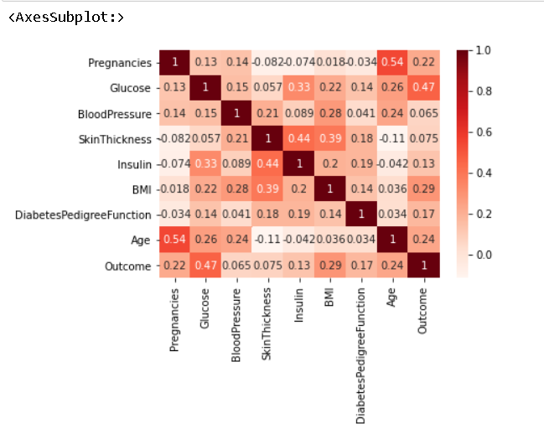
Data Visualization
The main goal of data visualization is to make it easier to visualize the information and to identify patterns in the dataset.
Charts and Graphs make the new data findings easier than the normal dataset.

Slide 26
Data Processing
Data processing refers to the technique of preparing the raw data into data that is suitable to build the model. Without this step, the model's accuracy may be reduced.
Missing values: Missing values can create problems. It is good if the missing value has been identified and replaced.
Feature Scaling: Feature Scaling is a technique used to normalize the range of features of the data. Feature Scaling brings all the values in the dataset to the same magnitude.
Removing Outliers: An outlier is an observation in a dataset that is different from other observations in the feature. It may occur due to input error or data corruption.

Slide 27
Model Deployment
The dataset has been split into two separate sets namely the training set and test set. A training set is a subset that is used to train the model; on the other hand Test set is the one that is used to test the predictions of the model.
The model fitting is a measure of how well a machine learning model generalizes to similar data to that on which it was trained. A well-fitted model produces more accurate outcomes. A model that is over fitted matches the data too closely.
The model is evaluated using different performance metrics. A model with good performance metrics is considered the best deployment model.

Slide 28
Prediction
The model is used for predicting the disease. Given the new input data, the model will predict the occurrence of the diabetics in a given record of the patient .

Slide 29
Implementation
The trained models produced results and gave us various insights from the dataset.
We can categorize into two sub divisions as follows :
  Accuracy Score
  Confusion Matrix

Slide 30
Conclusion
One of the important real-world medical problems is the detection of diabetes at its early stage. In this study, systematic efforts are made in designing a system which results in the prediction of disease like diabetes.
During this work, three machine learning algorithms are studied and evaluated on various measures. Experiments are performed on Pima Indians Diabetes Database.
Experimental results determine the adequacy of the designed system with an achieved accuracy of 83.12 % using the Logistic Regression algorithm.
In future, the designed system with the used machine learning algorithms can be used to predict or diagnose other diseases.

Slide 31
Thank You

